Slide 1

Daniel Beckett, Khaled Khaled, Lauren May, Taylor Yee

Slide 2
Introduction
Goal: to build an adaptable platform to provide help to children with mobility issues in their transition to drive electric powered wheelchairs (EPWs)
Clients:
  Dr. Kyle Winfree, Assistant Professor at Northern Arizona University
  Krista Branch, Physical Therapist (PT) in Flagstaff Unified School District (FUSD)
Khaled

Slide 3
Overview of Schedule
Estimated Completion Date
Power Subsystem
Sensors/Closed Loop Control
Mobility/Force Feedback
GUI
March 2nd
March 13th
April 3rd
April 13th
Khaled

Slide 4
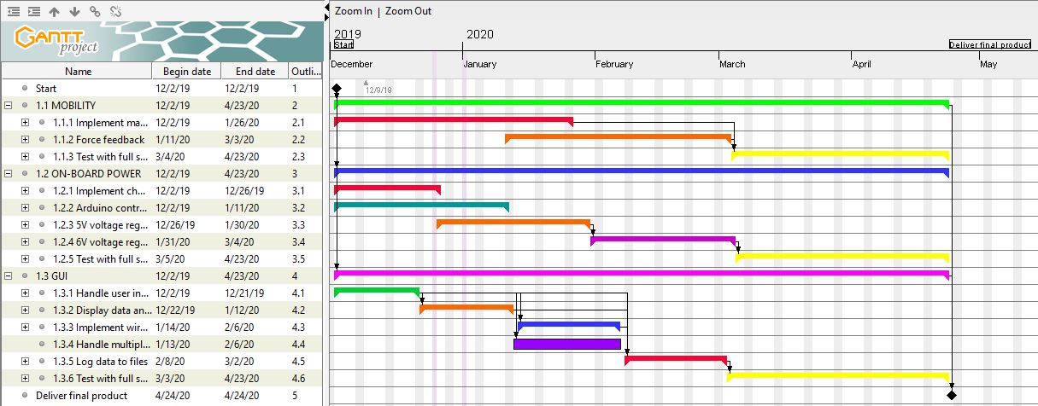
Gantt Chart
Khaled

Slide 5
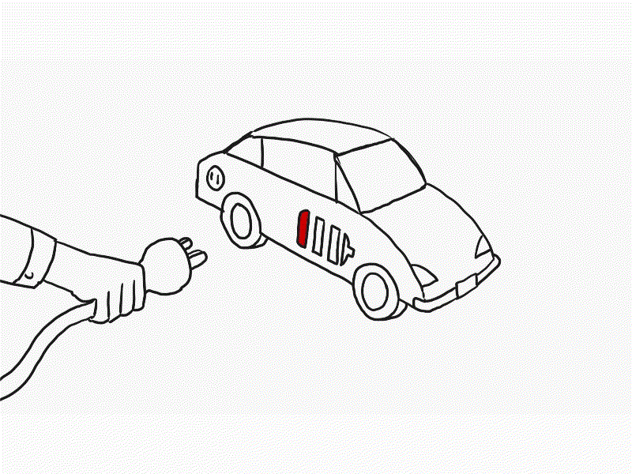
Subsystem 1: Power
A Fundamental Component for Final Product
Self-Sufficient to Power Entire System
Needs to Charge 12V Batteries
Easy to Use, No Extra Components Needed
All Other Subsystems are Dependent on the Power Module
Lauren

Slide 6
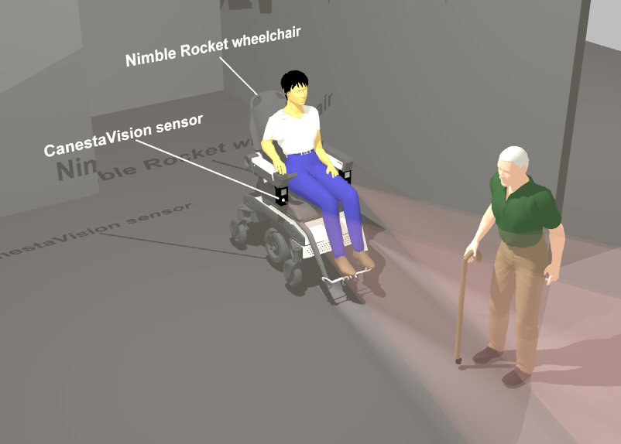
Subsystem 2: Sensors/Closed-Loop Control
Proximity Sensors Will Send Information to
Force Feedback Joystick
Display Real Time Data
Logging Data to Storage
This depends on the implementation of subsystem 1.
Lauren

Slide 7

Subsystem 3: Mobility
Dual 60A Motor Driver
Adjustable Maximum Velocity
Comfortable Ramping Speed
Additional User Inputs
Daniel
Notes:
I thought that might get our guys’ attention, but mostly do draw attention to the potential danger of unregulated mobility
Adjustable maximum velocity so younger users can start slow,
And comfortable ramping speed to ensure no-one's going be giving themself whiplash
And when we feel satisfied with our project, we plan to start development on implementing additional user inputs to expand the reach of our target audience
Now how the sensors are going to be affecting mobility is through something I like to call subsystem 3.2, Force feedback

Slide 8
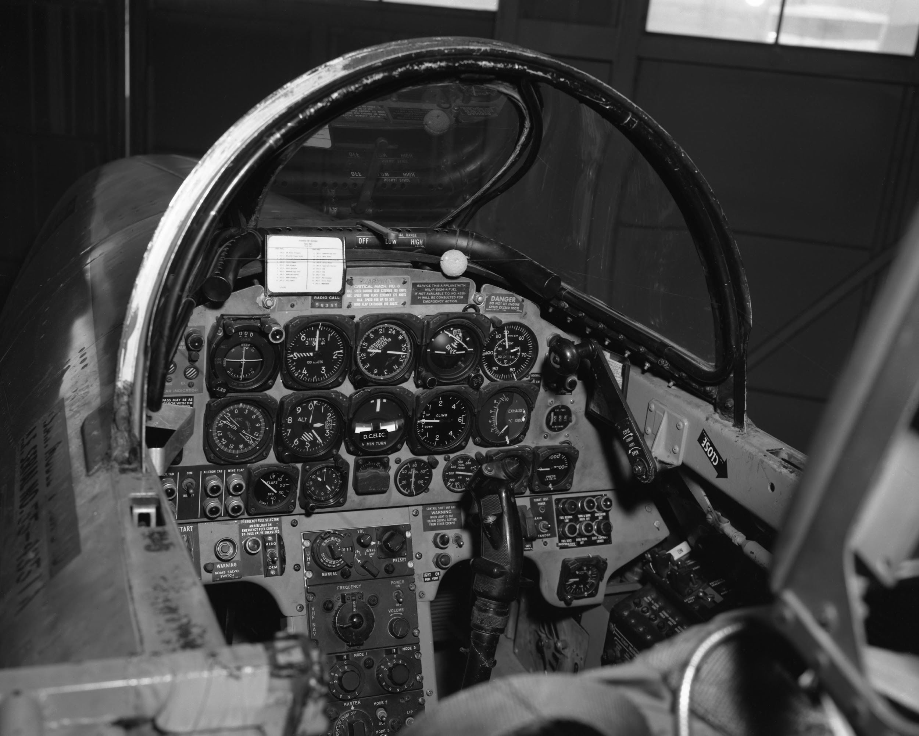
Subsystem 3.2: Force Feedback
Flight simulator joystick
Dependent on Proximity Sensors
Object Avoidance
Object Attraction
Daniel
Notes:
Using a joystick that was initially intended to mimic the forces acting on a jet for flight simulations
We will be customizing how the our proximity sensors will affect mobility through force feedback
Our intentions are to implement FF as an optional tool to either teach or test the user, depending on their skill.
Where Object avoidance will help users gain muscle memory by guiding their hands along with their path, around obstacles.
And object attraction will challenge any user to maintain a constant opposing force and grip to prevent collisions.

Slide 9
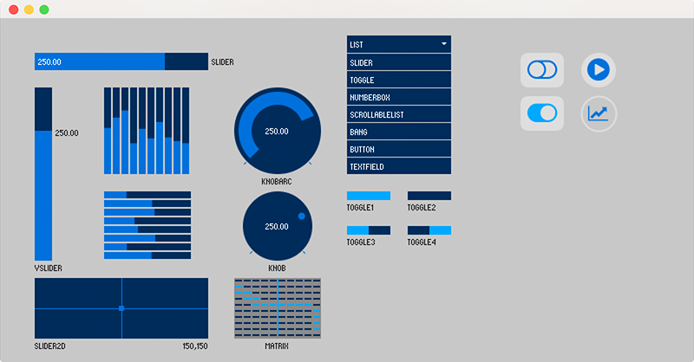
Subsystem 4: GUI
Two components:
Physical GUI that can be viewed and manipulated by client and team
  Data inputs and display rely heavily on functionality of other subsystems
Data logging portion to record sessions for later viewing
  Must be formatted well for PT
Taylor

Slide 10
Conclusion
Critical Path - Functional Product by Early April
Float - Testing Phases Allocated for Refining
Dependencies - Initially Independent Subsystems Allow for Greater Potential in Simultaneous Parallel Progress
Daniel
Notes:
Critical Path - Complete integration of all subsystems could take much longer than projected, but the goal is to have a functional, solid product by early April so that we have time to collect data before the final product
While finishing touches could continue forever, we aim to have a fully functional product by early April so ensure we have time to playtest our data collection and procedures.
Float comes in the form of a large testing phases for each individual subsystem.
This will allow us room tackle unforeseen challenges
As well as become accuanted with the kind of results we expect from each SS before embedding everything together.
Dependencies -
Luckily as I’ve mentioned, our SS are mostly independent, Except for the force feedback relying on sensor data.
Independent System features allow for wider potential of progress.

Slide 11

Questions?

